Slide 1
Data Structures and algorithms-3
25CS2103E
Module-3: Advanced Dynamic Programming

Slide 2
Topics at a Glance
1. Edit Distance & Variants
Levenshtein, Damerau-Levenshtein, Weighted edit distance
Wagner-Fischer algorithm
2. Sequence Alignment
Needleman-Wunsch (global), Smith-Waterman (local)
Gap penalty models
3. Interval DP
Matrix-chain multiplication, Optimal BST
O(n³) and O(n² log n) variants
4. Bitmask DP
Travelling Salesman in O(2ⁿ · n²), Hamiltonian path, Set-Cover
5. DP on Trees
Subset sums, Diameter & Centroid, Rerooting technique
6. SOS DP
Sum-Over-Subsets in O(n · 2ⁿ), Inclusion-Exclusion
7. When DP is the Wrong Tool
Greedy suffices, No overlapping subproblems, Exponential states

Slide 3
Edit Distance — Core Idea
Definition
Minimum number of single-character operations to transform string A into string B
Operations (Levenshtein)
Insert a character — "cat" → "cart"
Delete a character — "cart" → "car"
Replace a character — "car" → "bar"

Slide 4
Edit Distance — Core Idea
Example
edit_distance("kitten", "sitting")

Slide 5
Edit Distance — Core Idea
Example
edit_distance("kitten", "sitting")
k→s (replace),
e→i (replace),
+g (insert)
edit_distance("kitten", "sitting") = 3

Slide 6
Edit Distance
Recursive Approach
Base Condition: If either string is empty, return the length of the other string (insertion or deletion).
Recursive Steps:
  If the last characters match:
    Recursively call EditDistance(M-1, N-1).
  If the last characters don't match, consider three operations:
    Insert str1[N-1] at the end of str2: EditDistance(M, N-1).
    Replace str2[M-1] with str1[N-1]: EditDistance(M-1, N-1).
    Remove str2[M-1]: EditDistance(M-1, N).

Slide 7
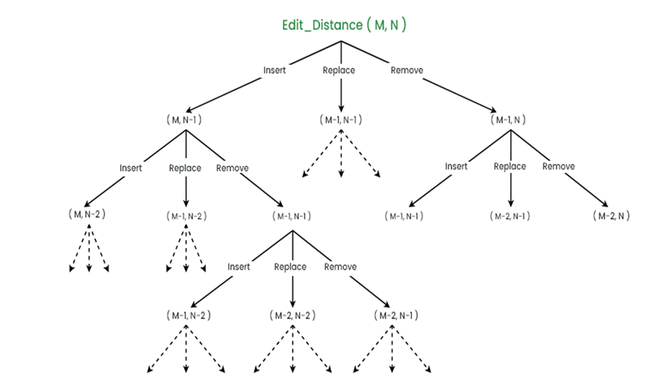
Edit Distance

Slide 8
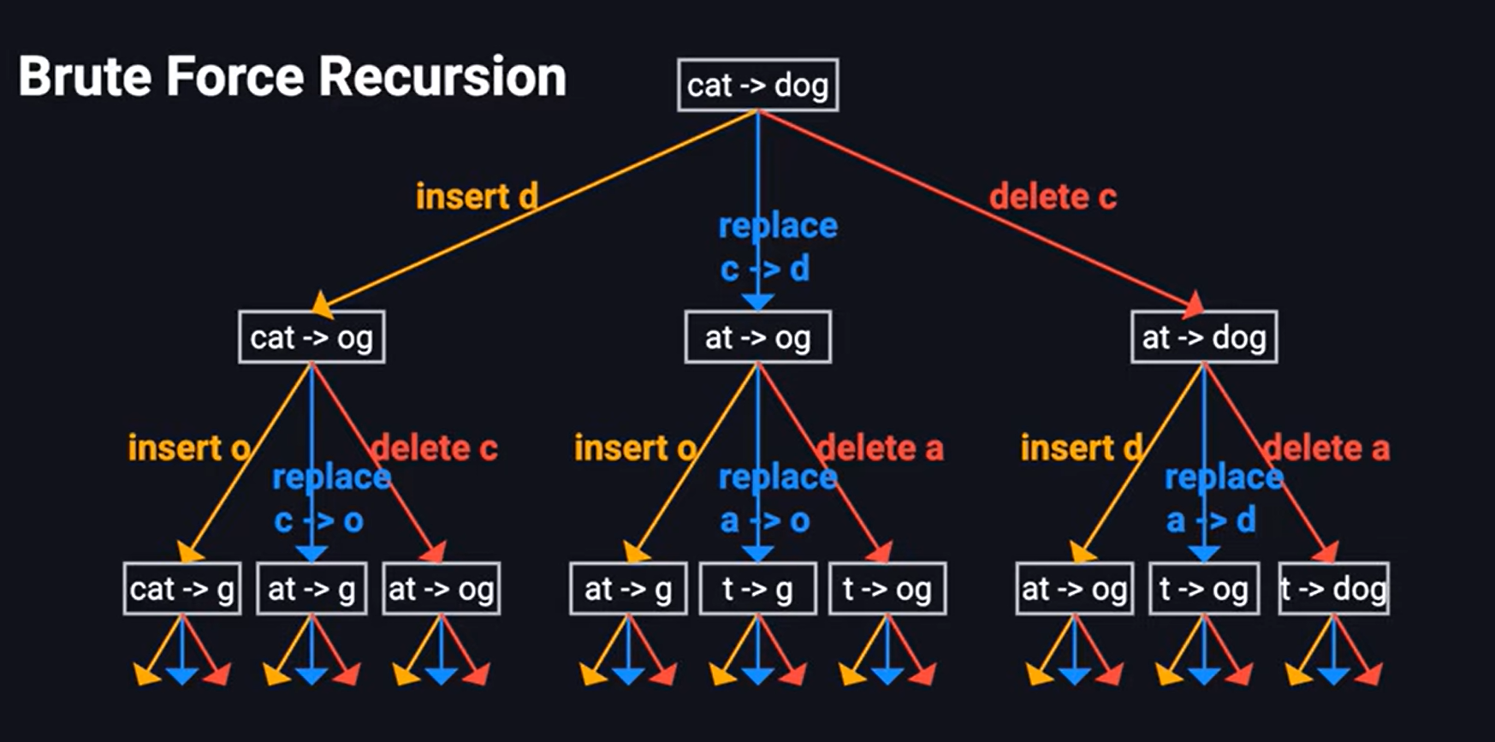
Edit Distance

Slide 9
Levenshtein Edit Distance — Core Idea
Levenshtein edit distance → defines what distance means.
The Levenshtein distance is a string metric for measuring the difference between two sequences.
Recurrence (Levenshtein)
dp[i][j] = dp[i−1][j−1] if A[i]==B[j]
else 1 + min{(dp[i-1][j], dp[i][j-1], dp[i-1][j-1])}
deletion insertion Substitution
Base: dp[0][j]=j, dp[i][0]=i

Slide 10
Wagner-Fischer Algorithm
The Wagner–Fischer algorithm is a dynamic programming algorithm that computes the edit distance between two strings of characters.
Wagner–Fischer algorithm → is a dynamic programming algorithm used to calculate Levenshtein distance.
The Dynamic Programming (DP) table in Edit Distance is a matrix that stores the minimum number of operations required to convert one string into another.
The allowed operations are:
Insertion
Deletion
Replacement (Substitution)

Slide 11
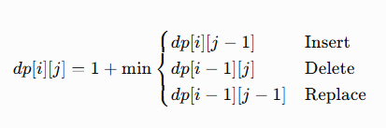
Edit Distance
Wagner-Fischer Algorithm
For every cell dp[i][j] compare X[i-1], Y[j-1]
Case 1: Characters are equal
No extra cost. dp[i][j] = dp[i-1][j-1]
a == a, Answer = diagonal value
Case 2: Characters are different
Take the minimum among
Insert
Delete
Replace

Slide 12
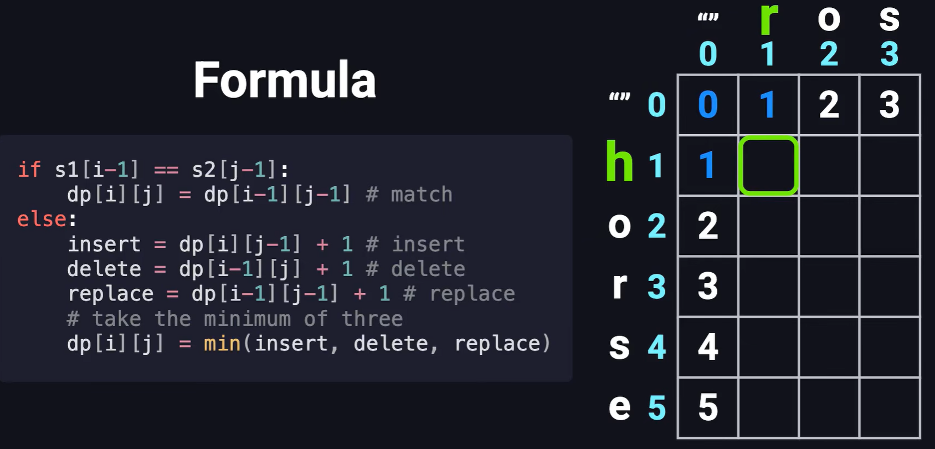
Wagner-Fischer Algorithm

Slide 13
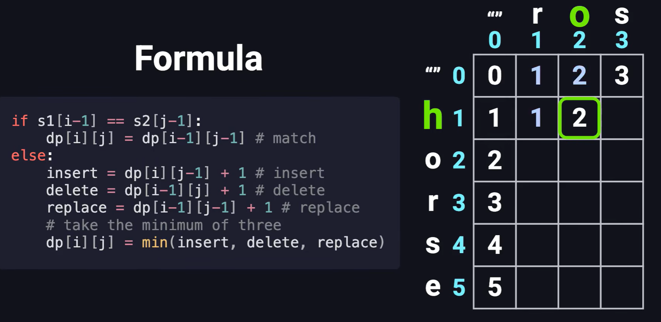
Edit Distance

Slide 14
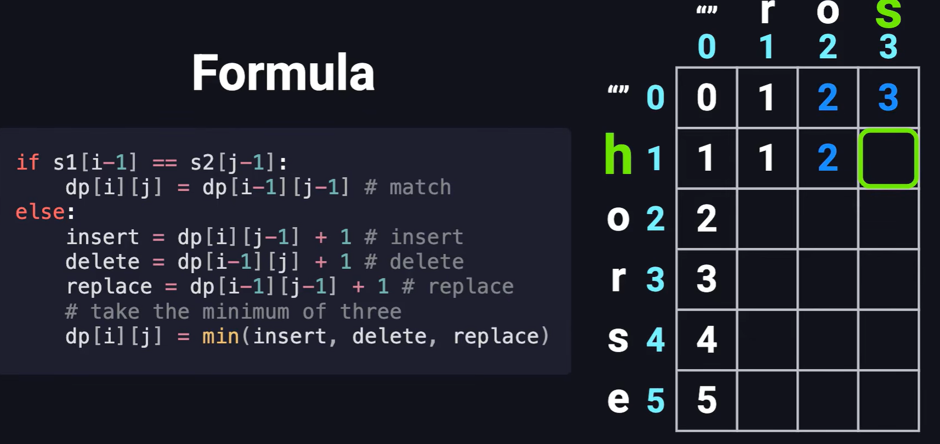
Edit Distance

Slide 15
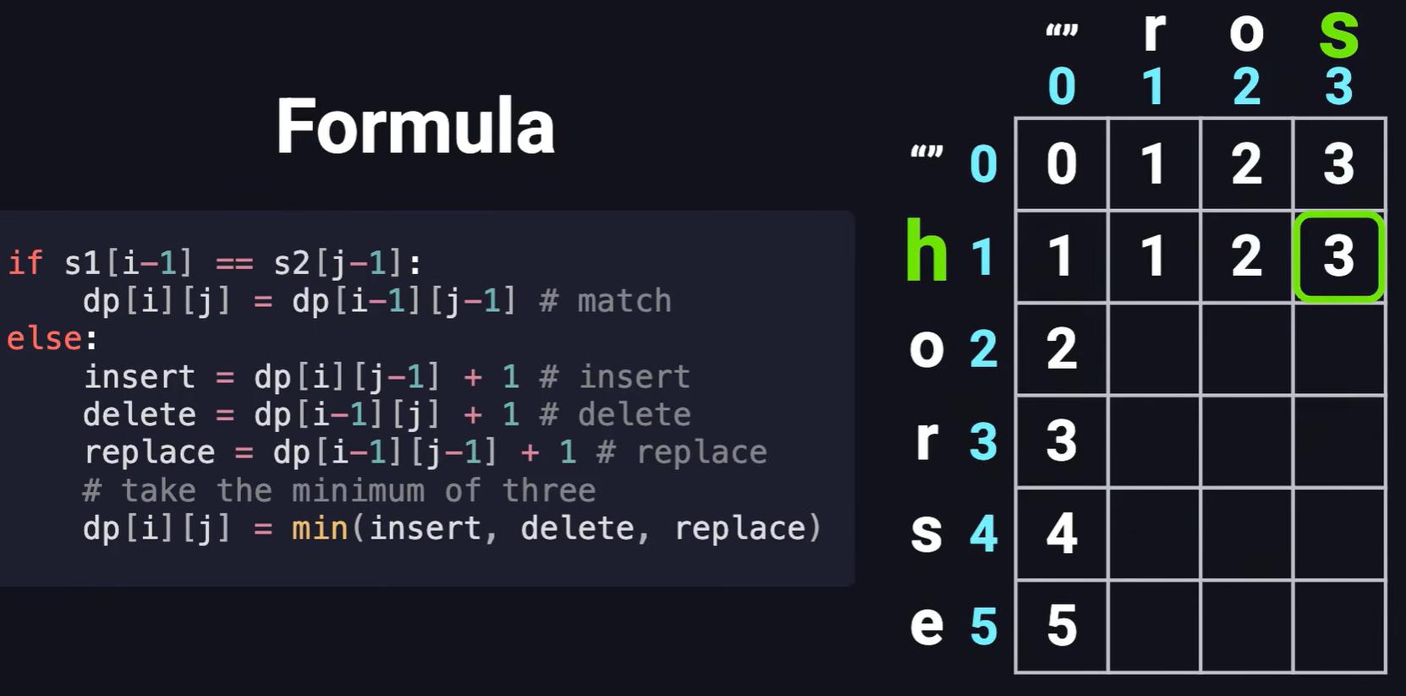
Edit Distance

Slide 16
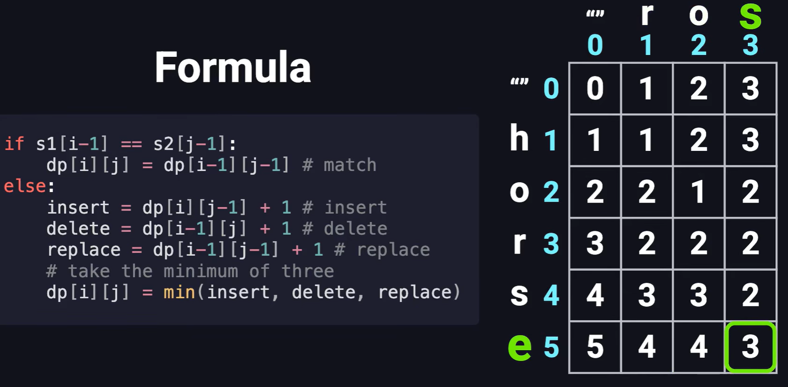
Edit Distance

Slide 17
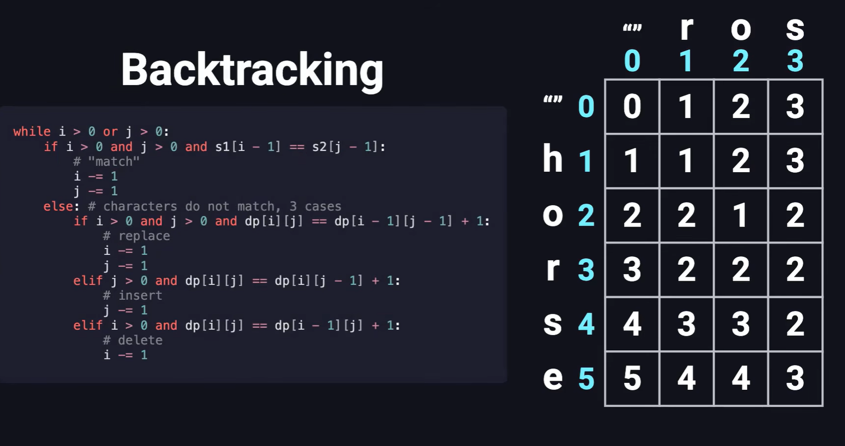
Edit Distance

Slide 18
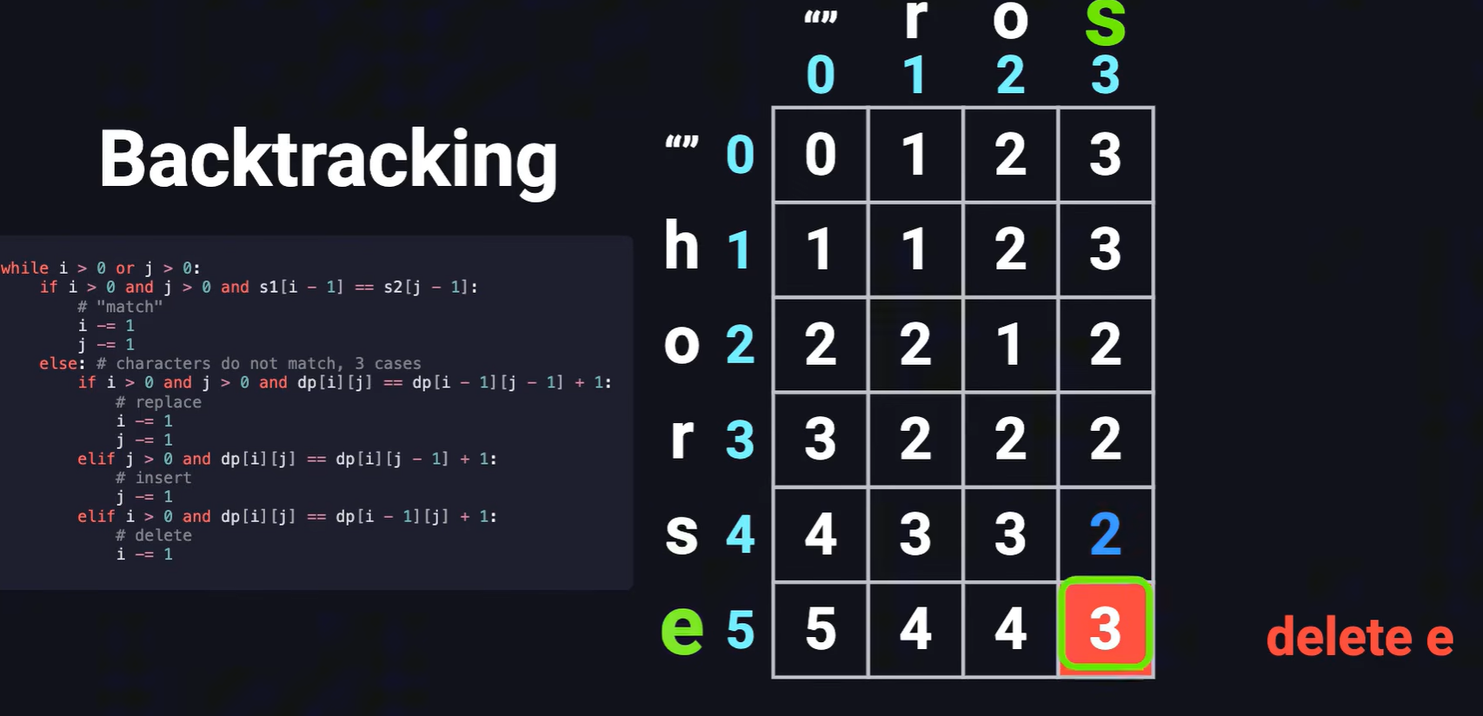
Edit Distance

Slide 19
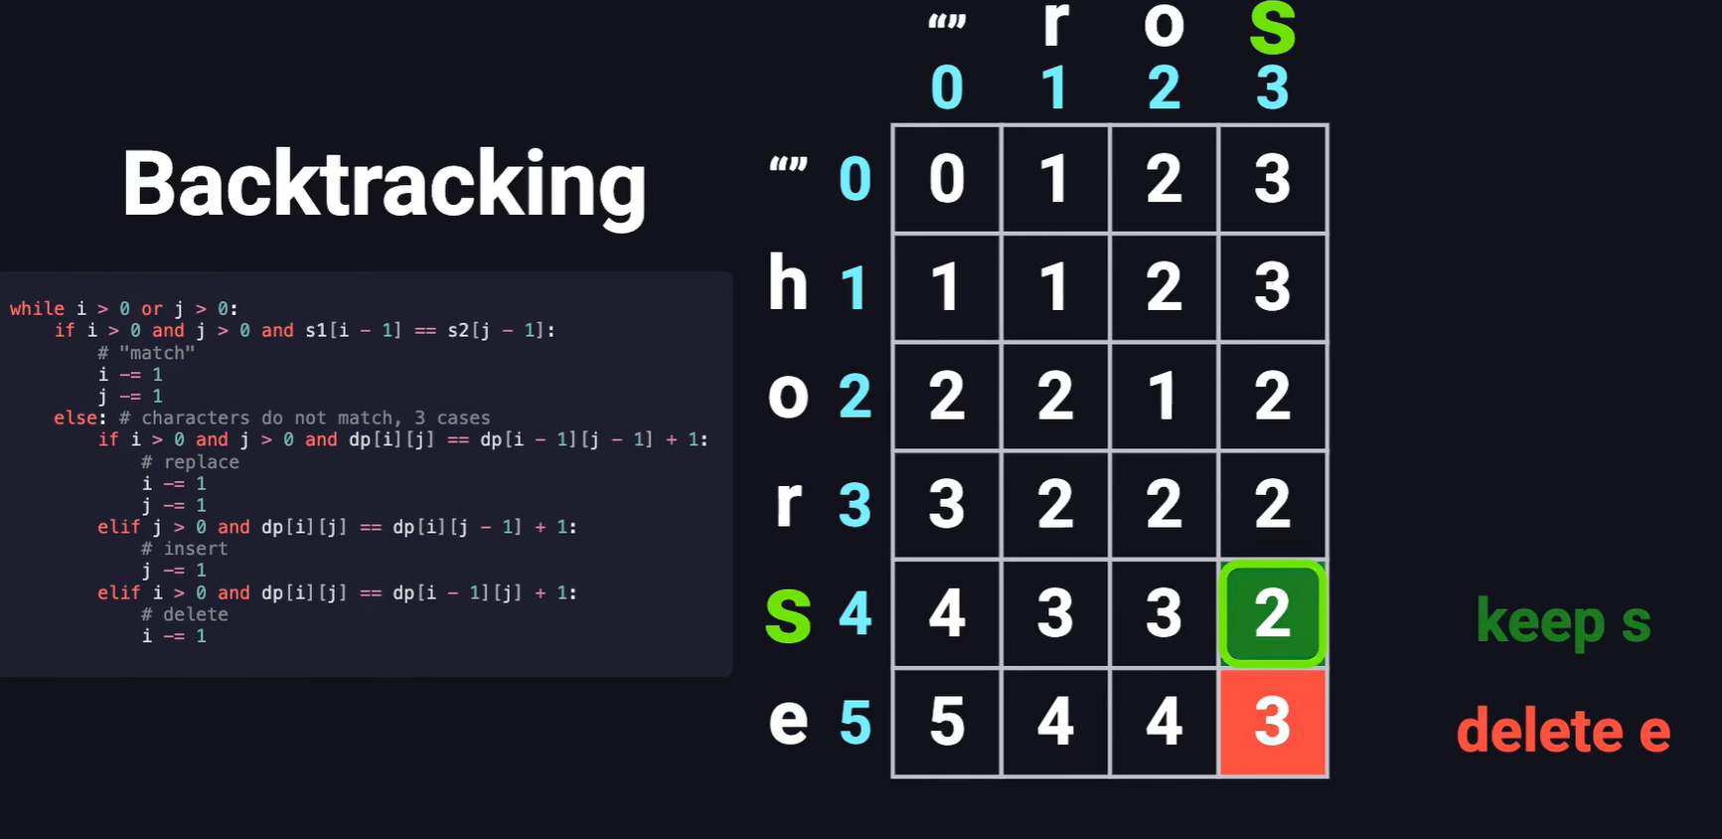
Edit Distance

Slide 20
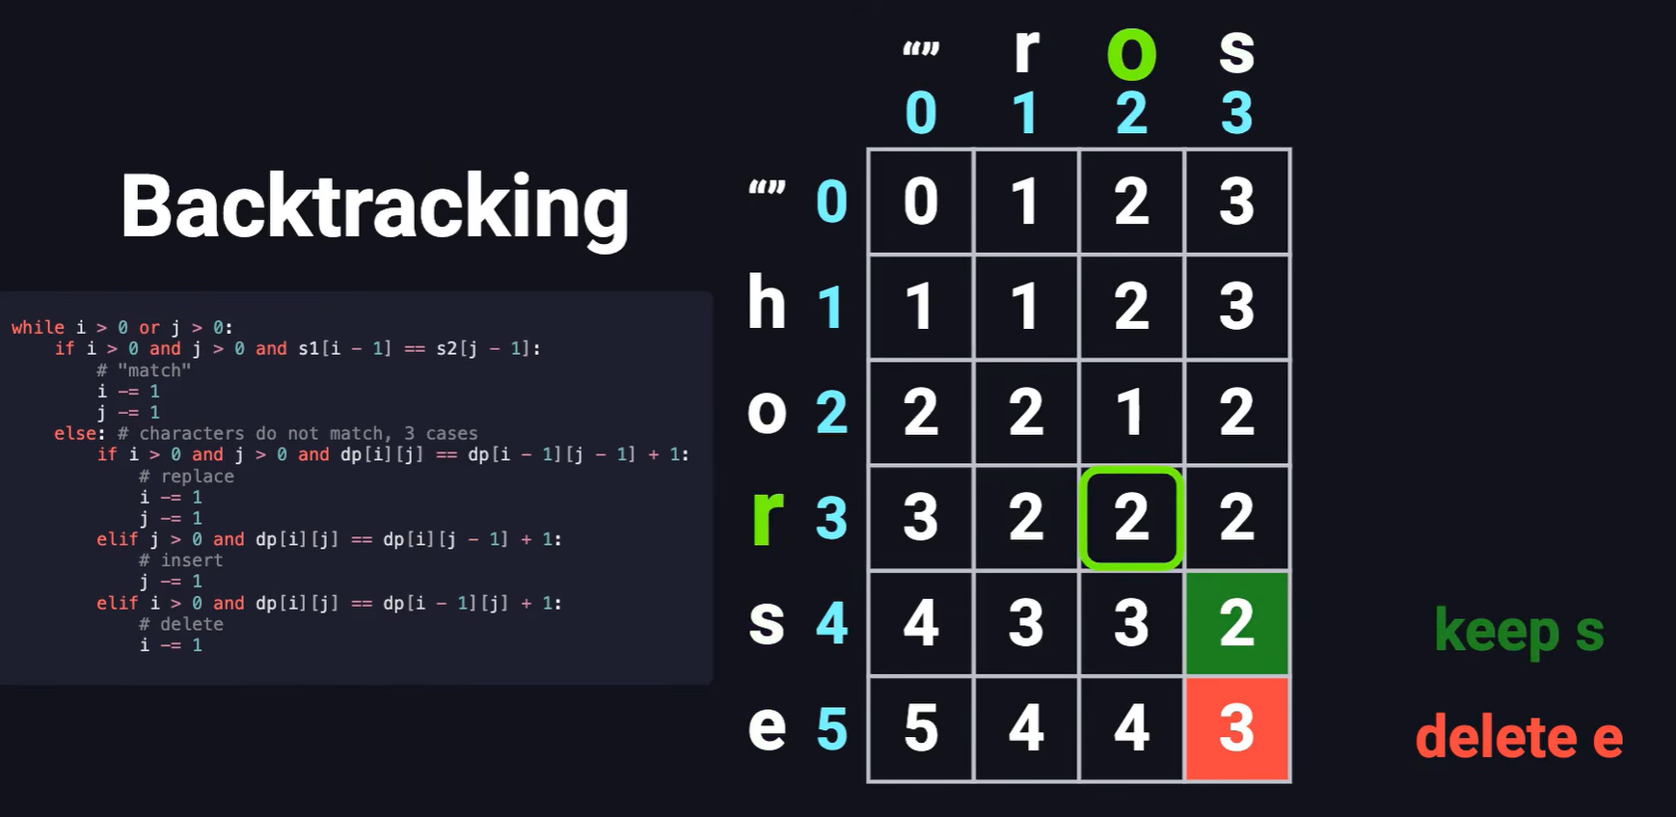
Edit Distance

Slide 21
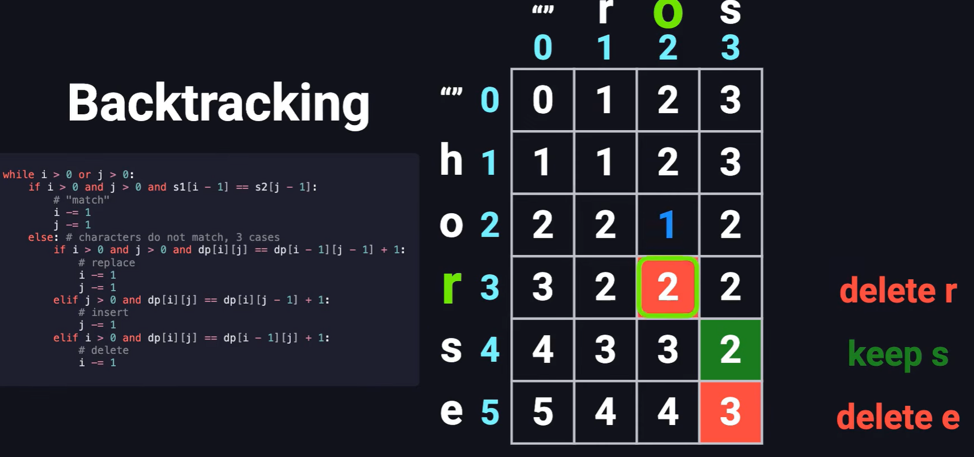
Edit Distance

Slide 22
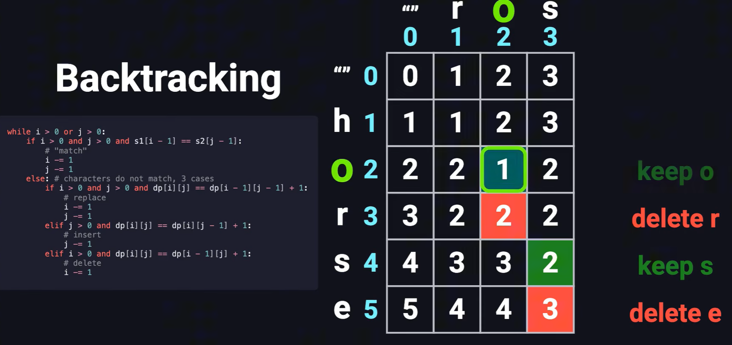
Edit Distance

Slide 23
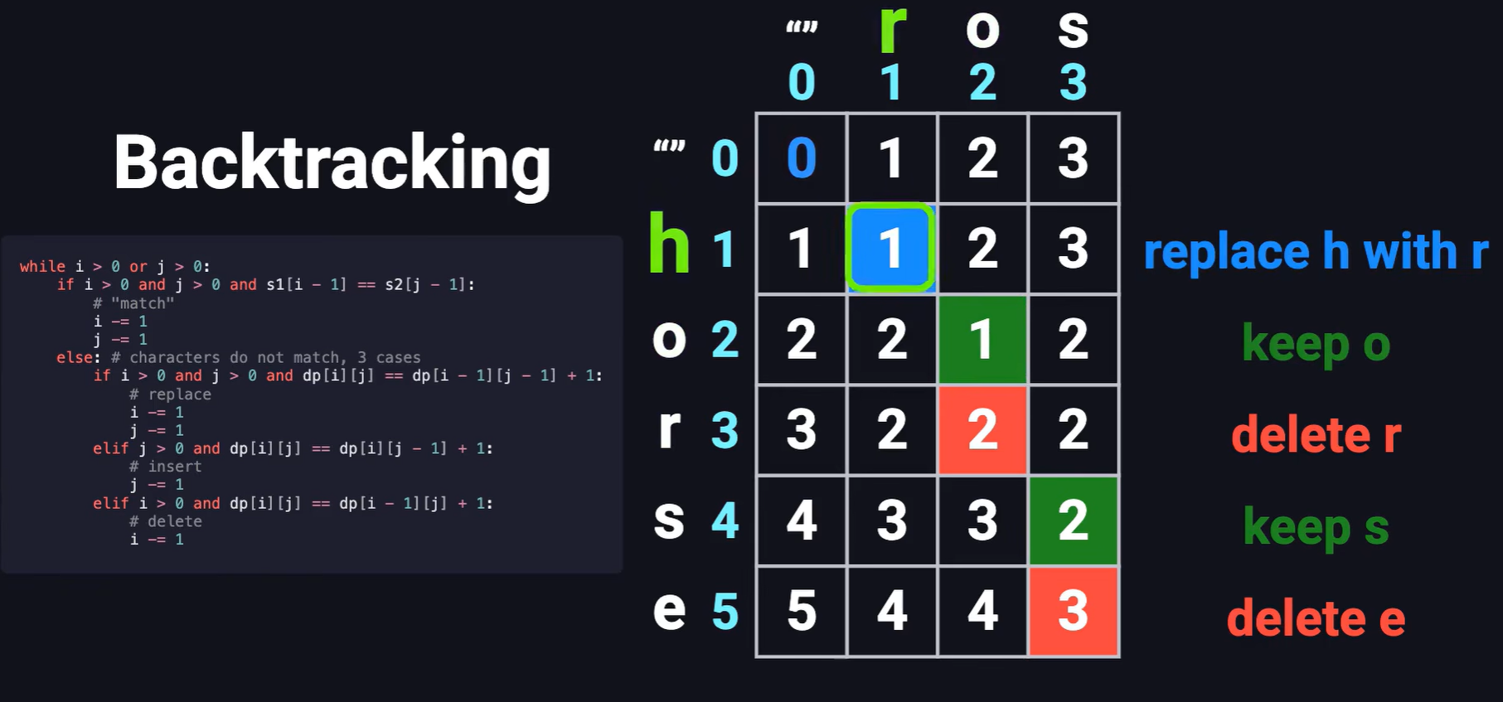
Edit Distance

Slide 24
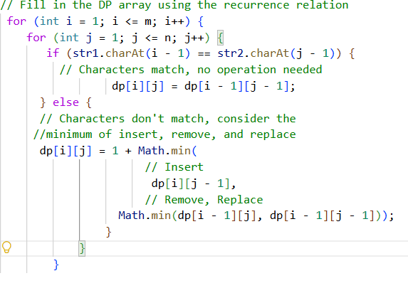
Pseudo code
int[][] dp = new int[m + 1][n + 1];
// Initialize the base cases
for (int i = 0; i <= m; i++)
{
dp[i][0] = i;
}
for (int j = 0; j <= n; j++)
{
dp[0][j] = j;
}

Slide 25
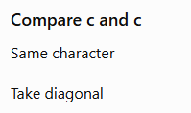

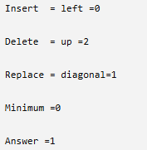
Edit Distance - Example
The first row and first column represent the empty string.
S1= “cat”
S2=“cut”
Initial Table
Ø c u t
----------------
Ø | 0 1 2 3
c | 1
a | 2
t | 3
We create a table of size (m+1) × (n+1),
m length of S1 and n length of S2
Ø c u t
----------------
Ø | 0 1 2 3
c | 1 0
a | 2
t | 3
Ø c u t
----------------
Ø | 0 1 2 3
c | 1 0 1 2
a | 2
t | 3

Slide 26
Edit Distance - Example
Continue similarly.
The completed table becomes
 | Ø | c | u | t
Ø | 0 | 1 | 2 | 3
c | 1 | 0 | 1 | 2
a | 2 | 1 | 1 | 2
t | 3 | 2 | 2 | 1
The bottom-right value is 1, meaning only one operation (replace a with u) is needed.

Slide 27
Edit Distance - Example
Continue similarly.
The completed table becomes
 | Ø | c | u | t
Ø | 0 | 1 | 2 | 3
c | 1 | 0 | 1 | 2 keep c
a | 2 | 1 | 1 | 2 Replace a with u
t | 3 | 2 | 2 | 1 Keep t
The bottom-right value is 1, meaning only one operation (replace a with u) is needed.

Slide 28
Edit Distance - Example
Other Example: algoritm → algorithm
The only difference is the missing letter h.
algoritm
algorithm
↑
The DP algorithm eventually computes
Edit Distance = 1
because only one insertion is required.
HW:
Compute the DP table and then determine what operations to be done based on the DP table?

Slide 29
Edit Distance - Wagner–Fischer algorithm
Why Does Dynamic Programming work?
Instead of solving the same subproblem repeatedly, DP stores intermediate answers.
For example, to compute
dp[5][6] it reuses previously computed values like:
dp[4][6], dp[5][5], dp[4][5]
This avoids redundant computation.
Time and Space Complexity
If the first string has length m and the second has length n:
Time Complexity: O(m × n) (every cell is computed once)
Space Complexity: O(m × n) (the DP table stores (m+1) × (n+1) values)

Slide 30
Edit Distance
Think of the DP table as a road map:
Each cell answers: "What is the minimum number of edits needed to convert the first i characters of String 1 into the first j characters of String 2?"
The algorithm fills the table from the simplest cases (empty strings) to the full strings.
The final answer is always in the bottom-right corner of the table.

Slide 31
PROCEDURE
1. Choosing Dimensions of Table: The state of smaller sub-problems depends on the input parameters m and n because at least one of them will decrease after each recursive call. So we need to construct a 2D table dp[][] to store the solution of the sub-problems.
2. Choosing Correct size of Table: The range of parameters goes from 0 to m and 0 to n. So we choose dimensions as (m + 1)*(n + 1)
3. Filling the table: It consist of two stages, table initialisation and building the solution from the smaller subproblems:
Table initialisation: Before building the solution, we need to initialise the table with the known values i.e. base case. Here m = 0 and n = 0 is the situation of the base case, so we initialise first-column dp[i][0] with i and first-row dp[0][j] with j.

Slide 32
Building the solution of larger problems from the smaller subproblems: We can easily define the iterative structure by using the recursive structure of the above recursive solution.
if (s1[i - 1] == s2[j - 1]) dp[i][j] = dp[i - 1][j - 1];
if (s1[i - 1] != s2[j - 1]) dp[i][j] = 1 + min(dp[i][j - 1], dp[i - 1][j], dp[i - 1][j - 1]);
4. Returning final solution: After filling the table iteratively, our final solution gets stored at the bottom right corner of the 2-D table i.e. we return dp[m][n] as an output.

Slide 33
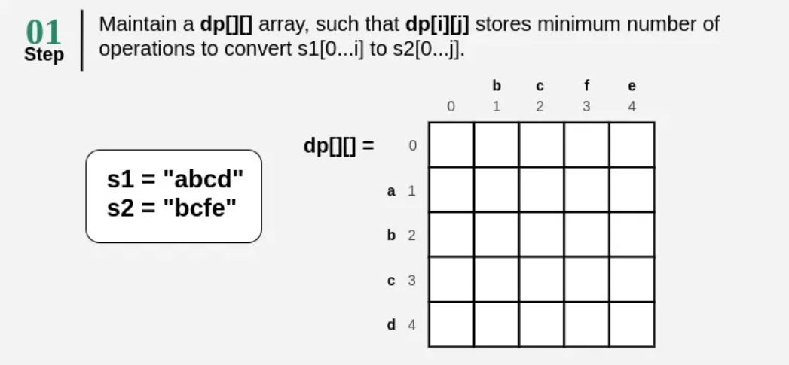
Edit Distance - Example

Slide 34
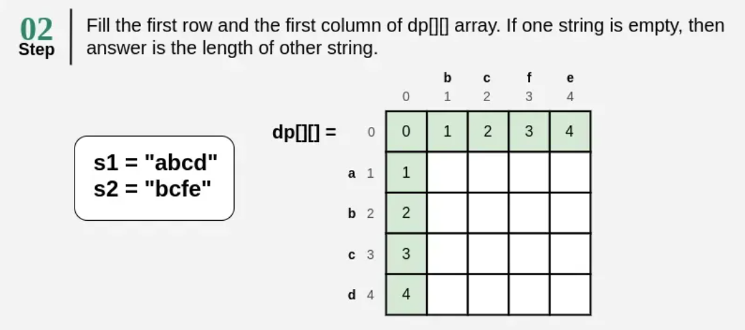
Edit Distance - Example

Slide 35
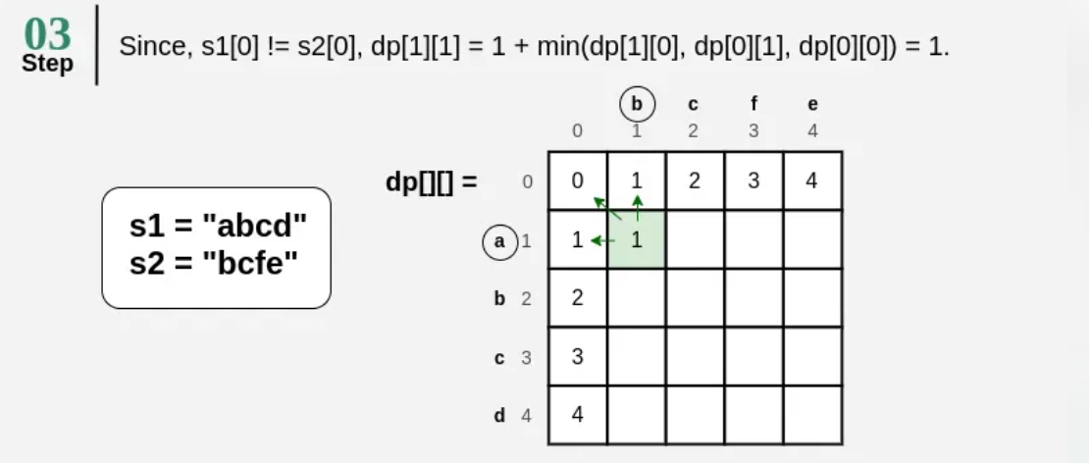
Edit Distance - Example

Slide 36
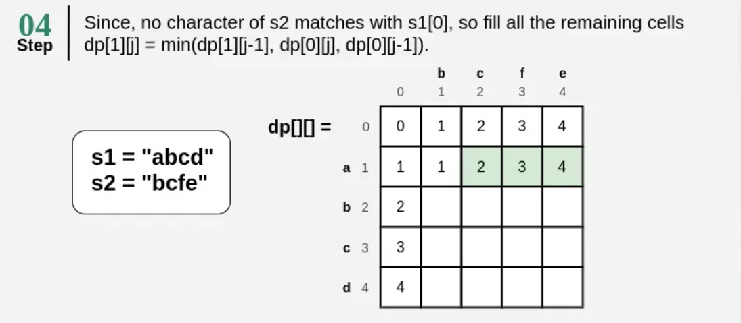
Edit Distance - Example

Slide 37
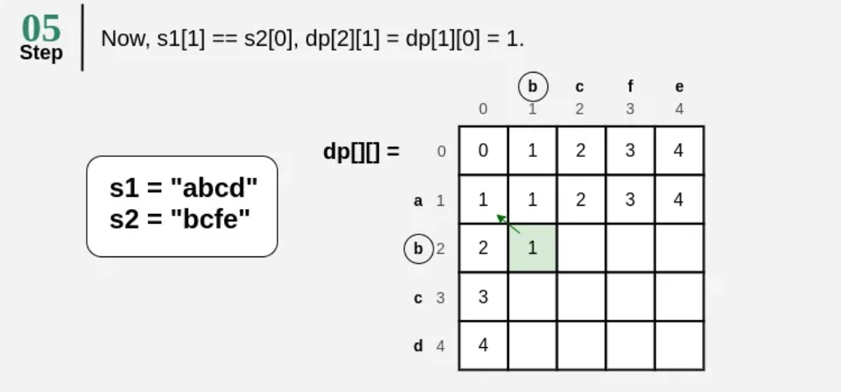
Edit Distance - Example

Slide 38
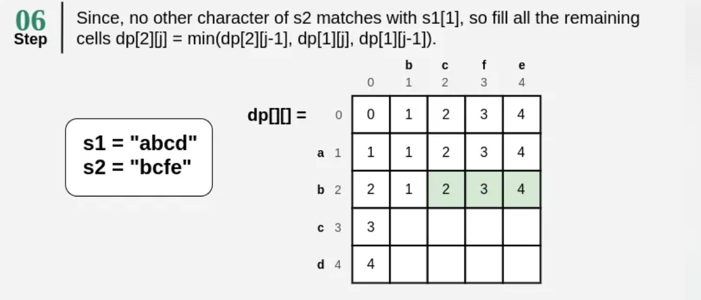
Edit Distance - Example

Slide 39
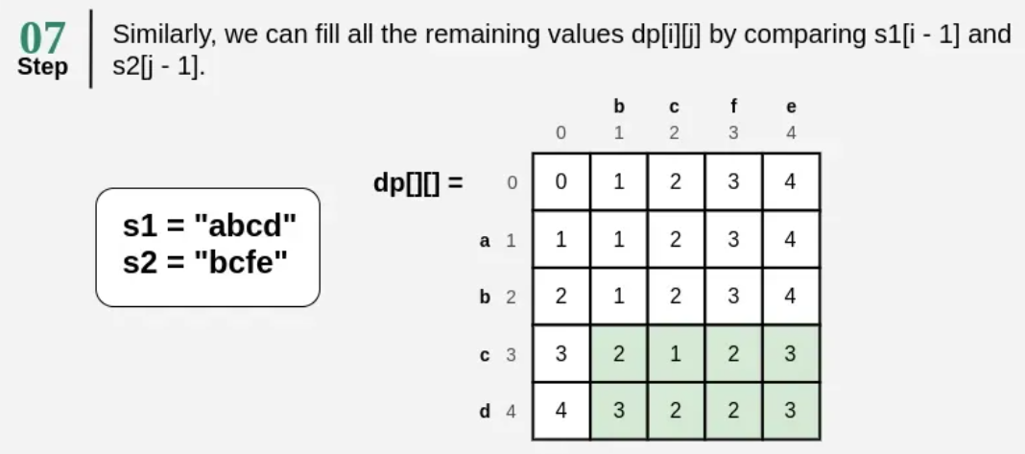
Edit Distance - Example
HW: Now determine what operations to be done based on the DP table?

Slide 40
Edit Distance - Example
Wagner-Fischer Algorithm
Example: "SUNDAY" → "SATURDAY“
"" S A T U R D A Y
"" 0 1 2 3 4 5 6 7 8
S 1 0 1 2 3 4 5 6 7
U 2 1 1 2 2 3 4 5 6
N 3 2 2 2 3 3 4 5 6
D 4 3 3 3 3 4 3 4 5
A 5 4 3 4 4 4 4 3 4
Y 6 5 4 4 5 5 5 4 3 → Answer: 3
HW: Now determine what operations to be done based on the DP table?

Slide 41
Edit Distance Variants
Damerau-Levenshtein:
Damerau–Levenshtein → extends Levenshtein by adding transposition.
Adds transposition: "ab" → "ba" costs 1 (not 2)
Example: edit_distance("ca", "abc") = 2 (transposition + insert)
Used in spell-checkers, DNA sequence comparison
Weighted Edit Distance
Weighted Edit Distance → assigns different costs to different operations.
Each operation has a custom cost: cost(insert c), cost(delete c), cost(a→b)
Example: keyboard proximity weights (p→o cheap, p→z expensive)
Recurrence: same structure, substitute 1 with cost function
Applications
Spell checking (Google "Did you mean...")
DNA/RNA similarity scoring
Plagiarism detection, version diff tools

Slide 42
Edit Distance Variants
String 1 = CA, String 2 = AC
We want to transform: CA → AC
1. Levenshtein Edit Distance
Allowed operations
Levenshtein allows: Insertion, Deletion, Replace. Transposition is NOT allowed. Usually, each operation has cost 1.
To convert: CA → AC, we cannot simply swap C and A.
One possible transformation is:
CA
↓
AA C → A
↓
AC A → C
That requires 2 substitutions.
Therefore: Levenshtein distance = 2
Key idea:Levenshtein distance tells us the minimum number of insertion, deletion, and substitution operations needed to transform one string into another.

Slide 43
Edit Distance Variants
String 1 = CA, String 2 = AC
We want to transform: CA → AC
2. Wagner–Fischer Algorithm
Now consider the same example:
CA → AC
Wagner–Fischer does not define a new type of edit distance.
It is an algorithm for calculating the Levenshtein distance using Dynamic Programming.
The DP matrix is:
"" A C
"" 0 1 2
C 1 1 1
A 2 1 2
The final cell is:
D[2][2] = 2
Therefore: Wagner–Fischer calculates Levenshtein distance = 2.
Levenshtein = WHAT distance to calculate
Wagner-Fischer = HOW to calculate that distance

Slide 44
Edit Distance Variants
String 1 = CA, String 2 = AC
We want to transform: CA → AC
3. Damerau–Levenshtein Distance
CA → AC
Damerau–Levenshtein adds one more operation:
Transposition
CA
↓
AC
The two adjacent characters are swapped. So only one operation is required.
Therefore:
Damerau–Levenshtein distance = 1
Therefore, for CA → AC, Levenshtein = 2, Damerau-Levenshtein = 1
Operations:
Insertion: Add a letter (e.g., cat → cats)
Deletion: Drop a letter (e.g., cats → cat)
Replace: one letter for another (e.g., cat → cut)
Transposition: Flip two neighbouring letters (e.g., teh → the)

Slide 45
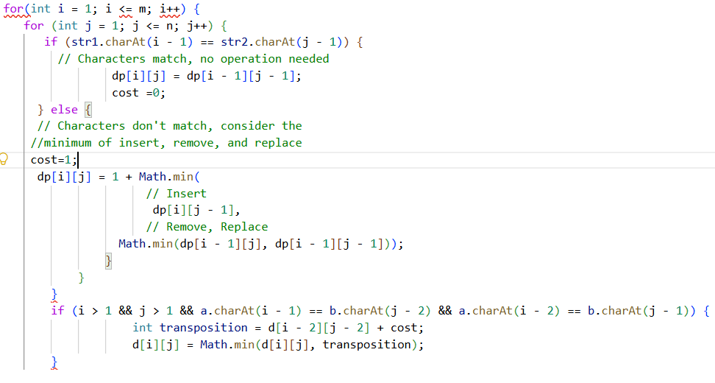
Damerau Levenshtein
DL extra
code

Slide 46
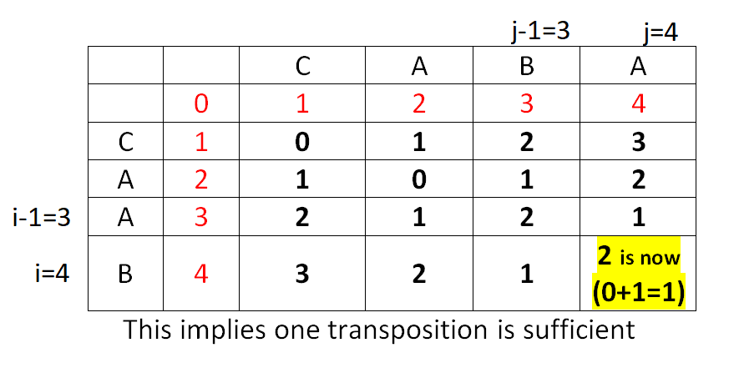
Damerau Levenshtein

Slide 47
Edit Distance Variants
String 1 = CA, String 2 = AC
We want to transform: CA → AC
4. Weighted Edit Distance
Now consider the same example:
CA → AC
In ordinary Levenshtein distance, we normally assume: Insertion = 1, Deletion = 1, Substitution = 1
But in Weighted Edit Distance, we can assign different costs.
Suppose: Insertion = 1, Deletion = 1, Substitution = 2
There is no transposition operation in our weighted model.
To convert: CA → AC
using two substitutions:
CA
↓
AA
↓
AC
Cost: 2 + 2 = 4
But we can do:
CA
↓
A delete C
↓
AC insert C
Cost: 1 + 1 = 2
Therefore the minimum weighted edit distance = 2.
This demonstrates an important point:
In Weighted Edit Distance, the answer depends on the costs assigned to the operations.

Slide 48
Thank you

